Slide 1

Understanding Septic
Re-Inspections

Slide 2
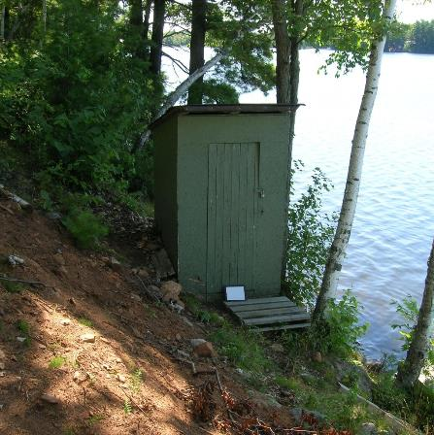
Class 1 – Privies
Also known as:
  Outhouse
  Earth Pit Privy
  Vault Privy
Composting toilets are a Class 1
  Overflow from Composting toilet must be directed to a Class 3,4, or 5.
No permit required for installation
Construction requirements and SEPARATION distances provided in Ontario Building Code and can be enforced

Slide 3
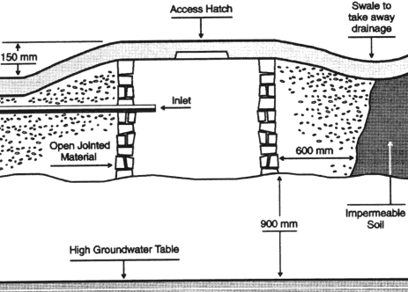
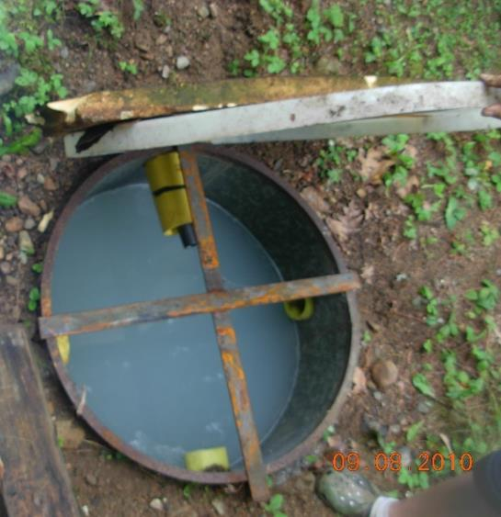
Class 2 – Greywater Pit
Also known as :
    French Drain
    Dry Well…
Can only accept waste from fixtures – i.e. sinks, showers…
Permit required prior to construction
Systems can be very large depending on conditions

Slide 4
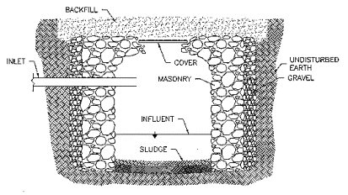
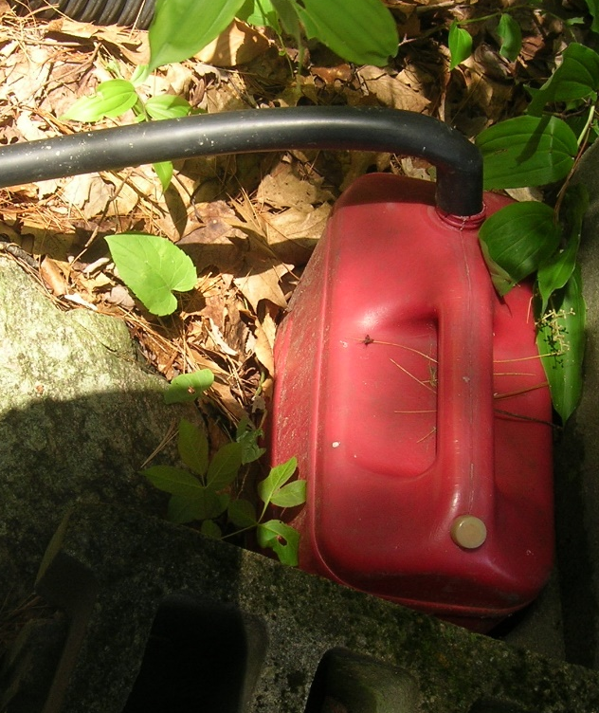
Class 3 - Cesspool
Only accepts waste from a Class 1 system
Permit required prior to construction
Not very common

Slide 5
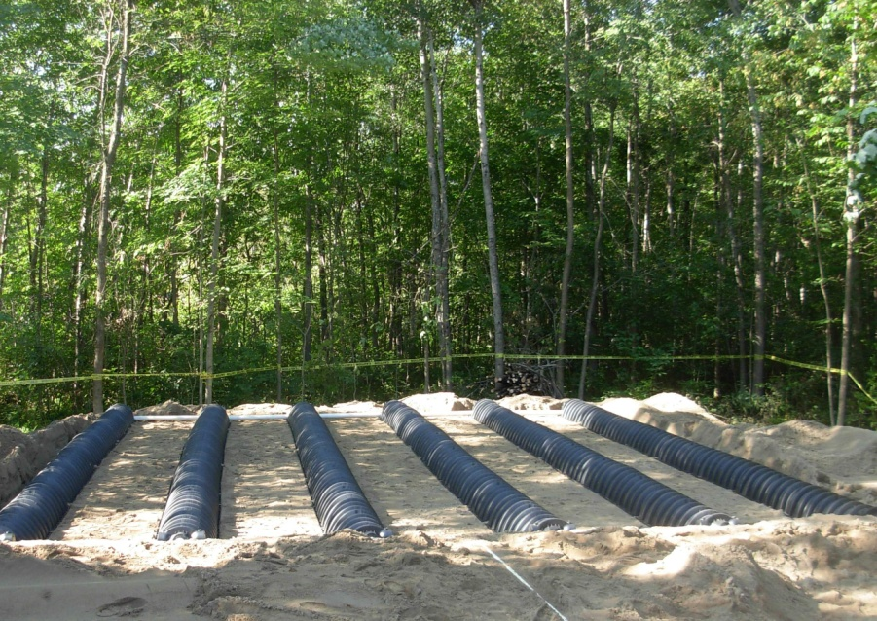
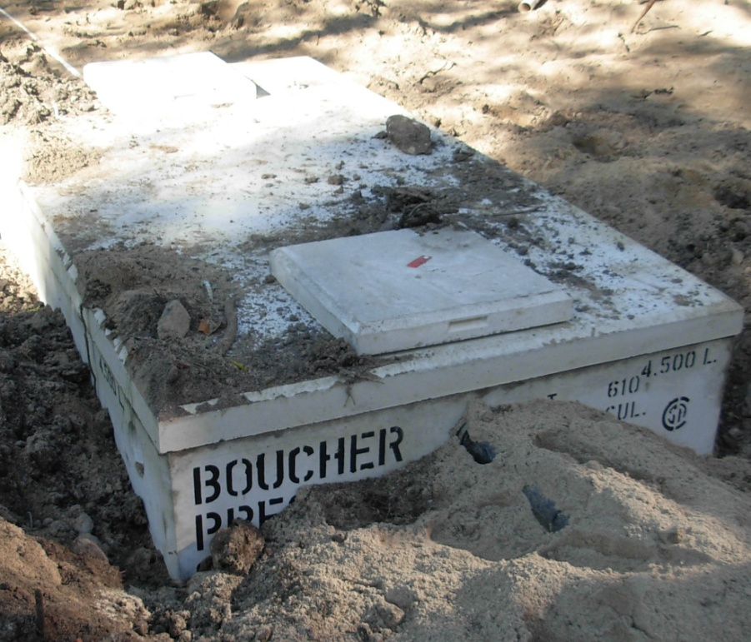
Class 4 –
Septic Tank &
Distribution Field
Most common system
Accepts both black water and greywater
Different configurations:
  Trench bed
  Filter media
Level IV treatment
  Higher level of effluent quality
  = better for the environment
  Overall system size can be smaller
  = less imported fill

Slide 6
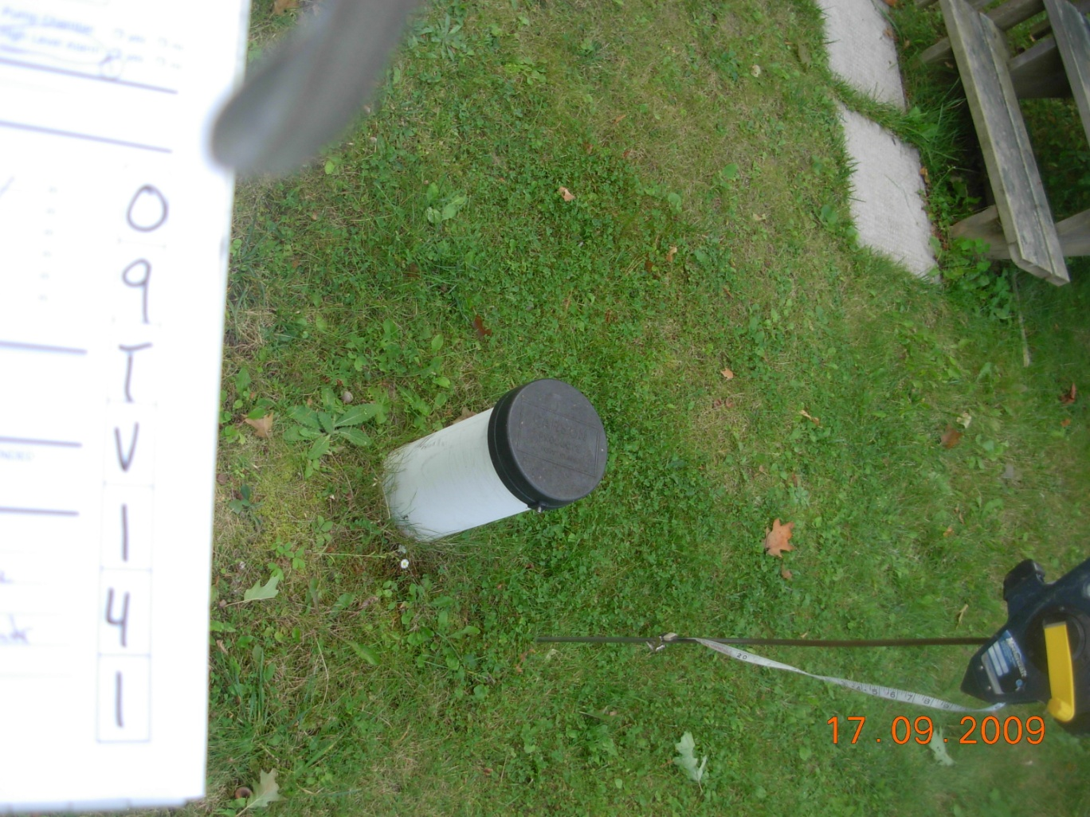
Class 5 – Holding Tank
No on-site treatment or disposal of sewage
Not very common in recent years – all other avenues exhausted prior to installation
Signed Agreement required with Licensed Sewage Hauler
Minimum tank size is 9000L

Slide 7
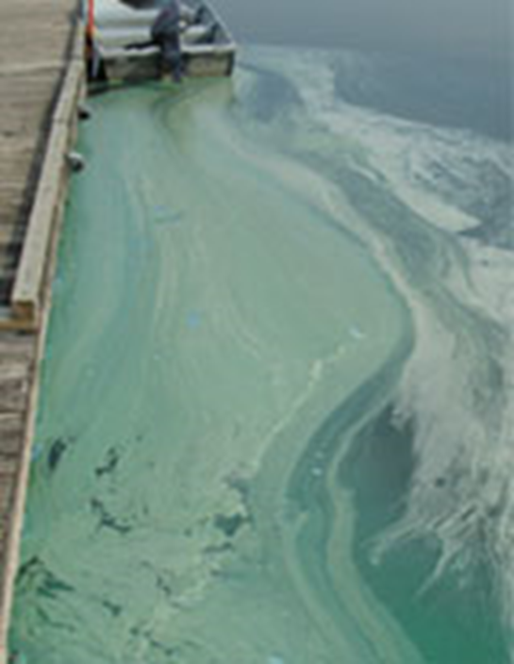
Understanding Septic Re-Inspections
Impacts of a malfunctioning or failed system include:
Environmental degradation
Public health risks
Depreciated property values.
Blue
Green
Algae

Slide 8
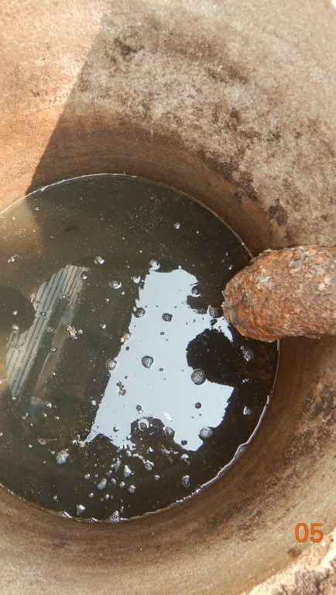
Understanding
Septic Re-Inspections
Programs generally based around Section 8.9 of the Ontario Building Code:
  How systems are to function
  Operated and Maintained in accordance to the Act or predecessor legislation
  When systems need to be pumped / sampled / inspected

Slide 9
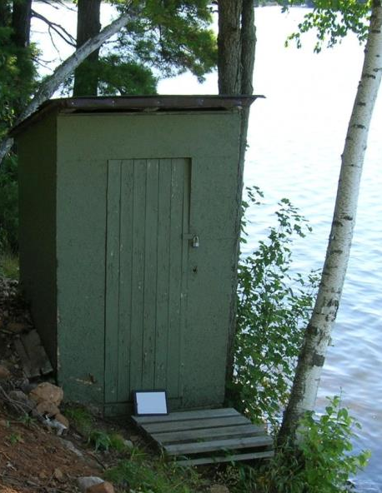
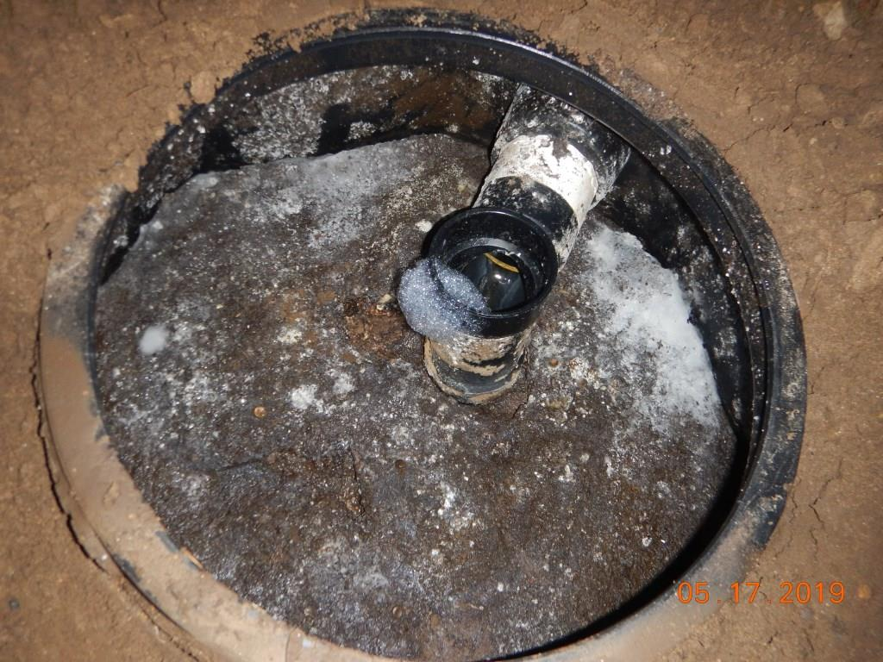
Misunderstandings/Myths
Outhouses not allowed
Class 1 system
Construction requirements
Exempt from permitting
System needs to meet Current Code
OBC Section 8.9
Predecessor Legislation
Homemade systems always need to meet code

Slide 10
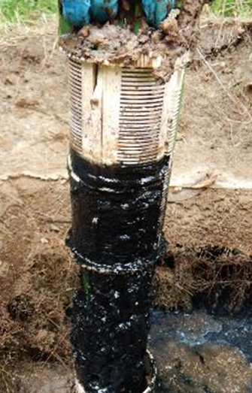
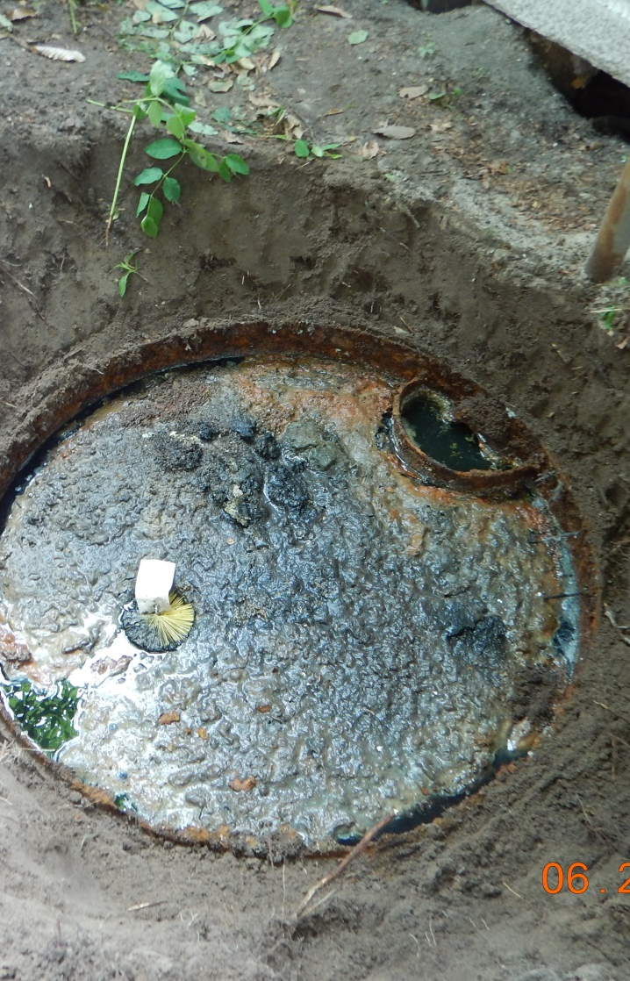
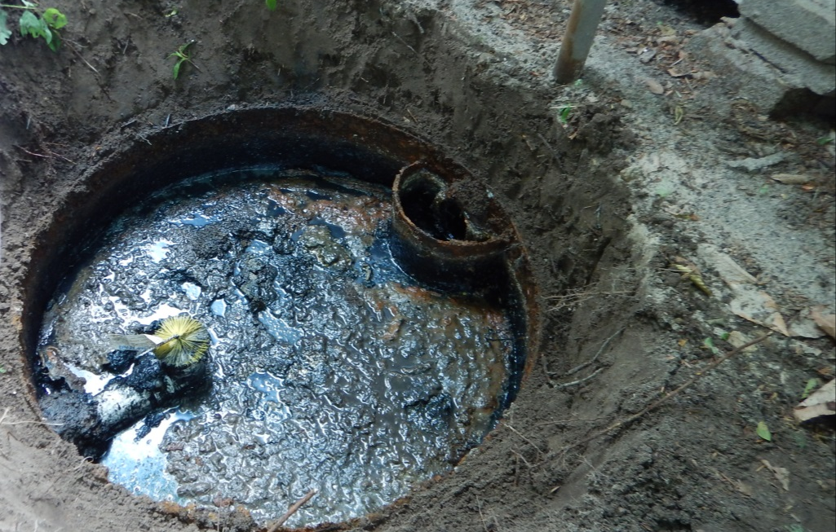
Misunderstandings/Myths
Effluent filters don’t work
Maintenance required
Inspectors will just show up
MRSSO inspectors will not conduct an inspection without communication with owner.

Slide 11
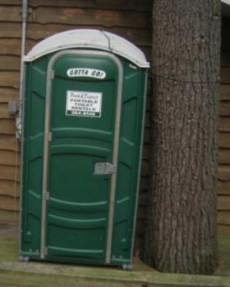
Misunderstandings/Myths
Inspector needs to enter dwelling
Building Code Act only allows enter on to property
Request for water to be run in dwelling to assist inspection
Cottages will be shut down
Worse case - system can not be used until repaired/replaced
Alternatives can be put in place

Slide 12
Misunderstandings/Myths
Tank needs to be pumped for inspection
Inspection should occur with tank at operating level
Sludge and scum measurements can determine if pumping needed

Slide 13
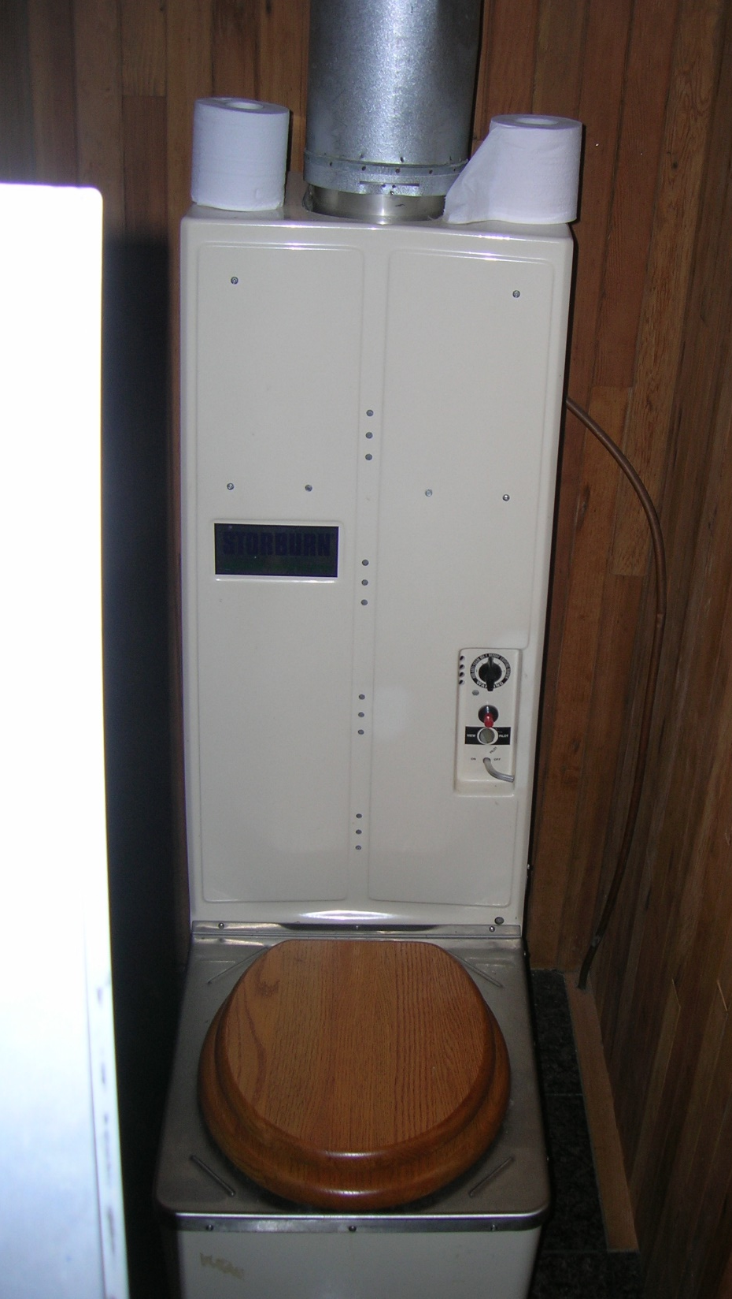
Misunderstandings/Myths
Replacement will cost $10,000’s
  May cost $10,000’s
  OBC provides 5 Classes of systems – less expensive alternatives
    Outhouse/composting/incinerating toilet
    Greywater pit – some can be dug by hand – if you enjoy digging
Seasonal property use – less often tank pumping
  Septic tank treatment less efficient with periodic use
  Over winter – bacteria dormant or die off
  Solids accumulate during system startup - spring

Slide 14
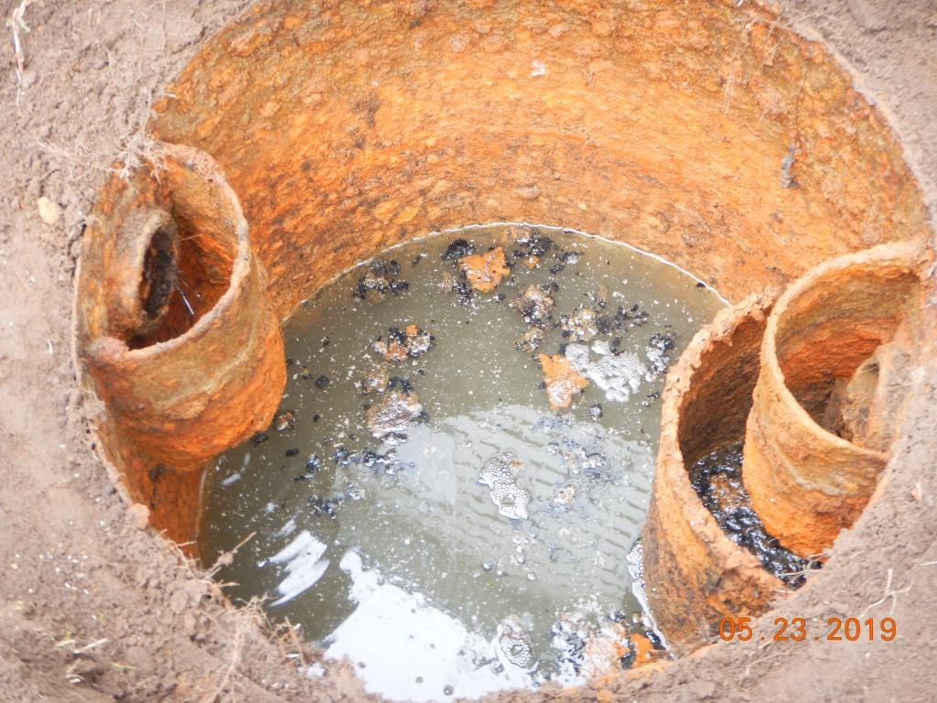
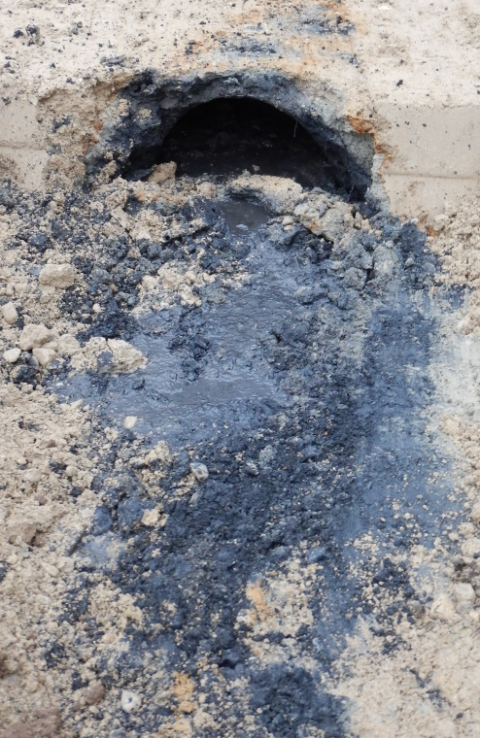
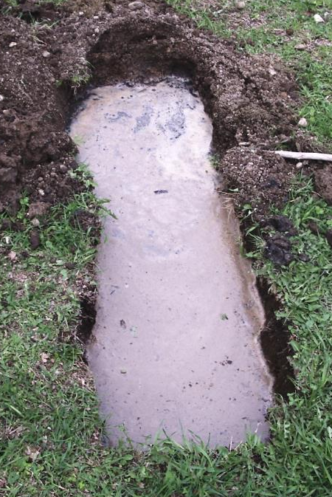
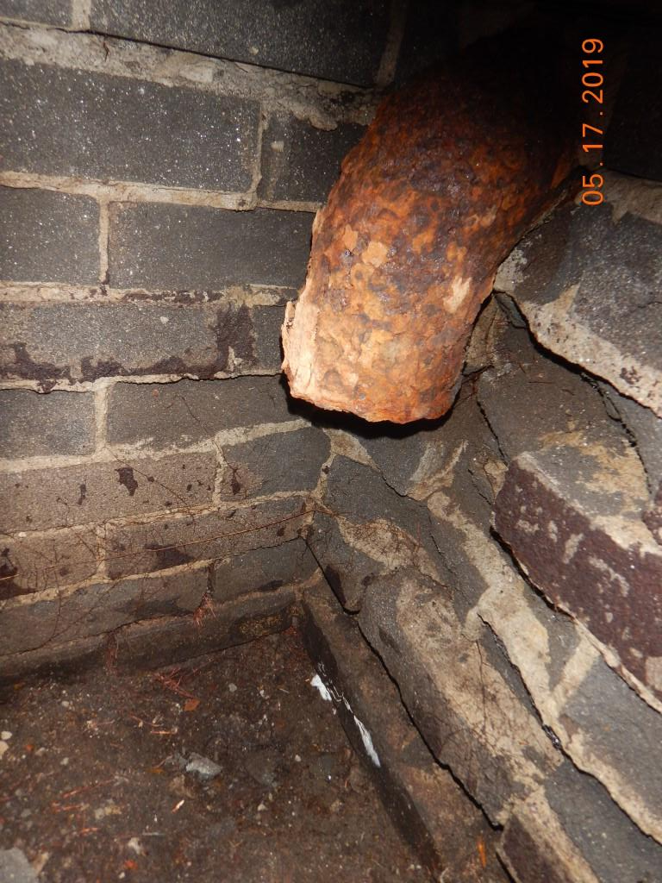
All Systems Will Fail

Slide 15

Thank you
Eric Kohlsmith, Part 8 CBO
613 253-0006 x. 256
mrsso@mvc.on.ca

